Slide 1
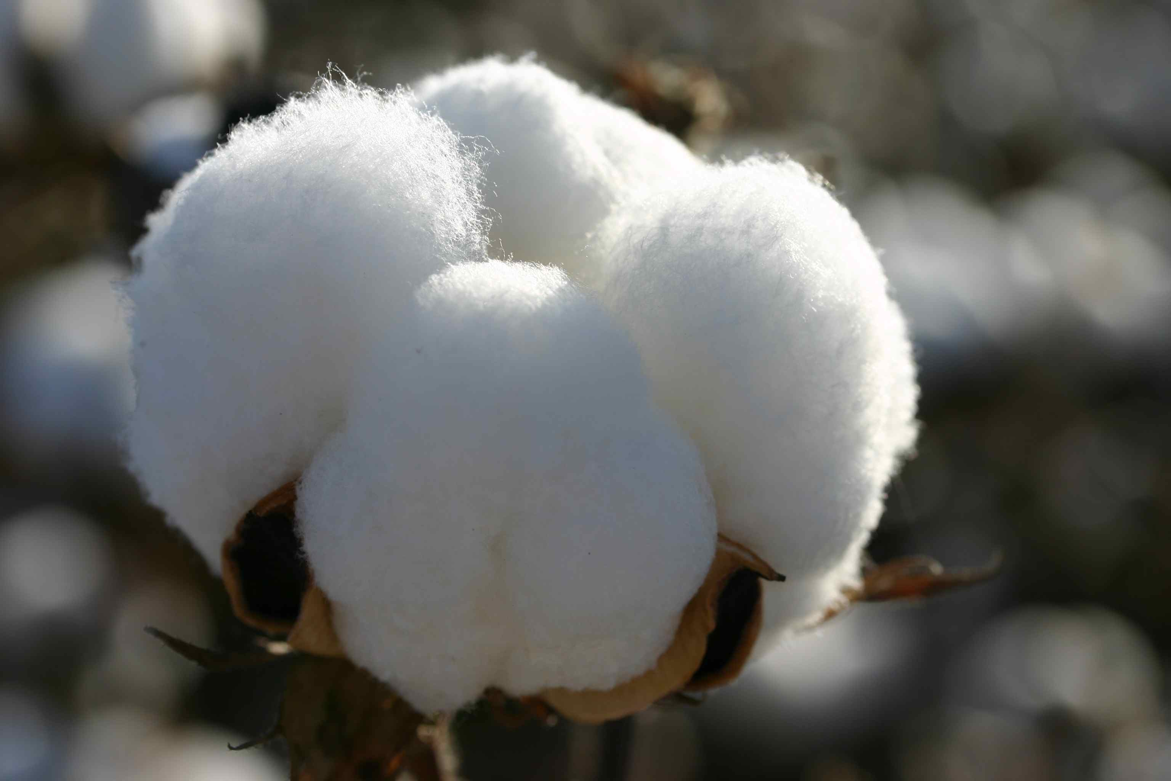
Cotton
Mikuláš Suchanovský VIII.A

Slide 2
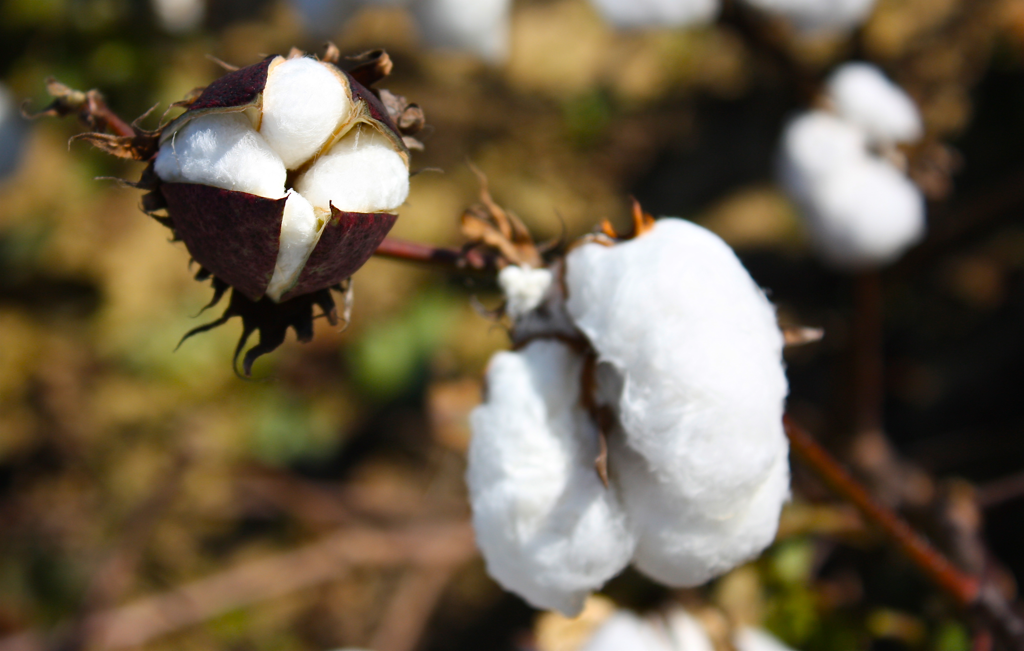
Description
Cotton is material that we harvest from plants. Cotton is white, soft and fluffy fiber that grows in a protective shell around the seeds of the plant. It is used to make thread that is later used to make soft and comfortable cloth.

Slide 3
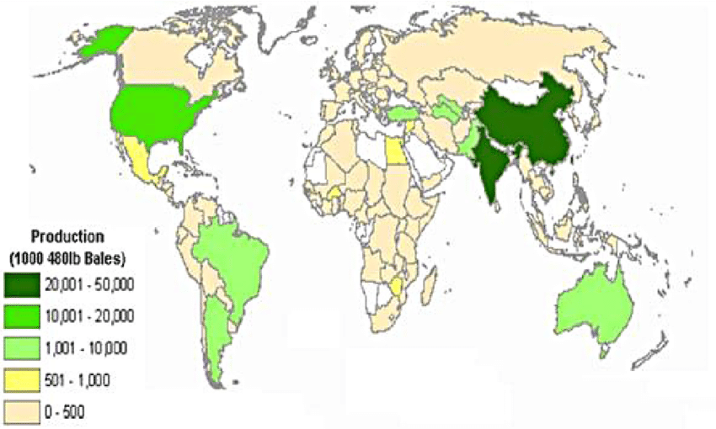
Origin
The plant grows mostly in tropical and subtropical atmosphere all around the world (for example America, India, Africa, Australia, etc.). About 25 million tonnes of cotton is produced all over ther world. The biggest cotton producers are India and United States of America.

Slide 4
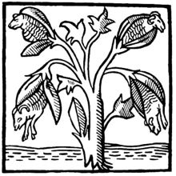
History
First evidence of use is dating back to the Prehistoric Age. Fragment of cotton fabric was found about 6000 BC, in Peru. More evidence was also found in South Asia, America, Arabia, Iran and China, all of them dating from 5500 BC to year 220.
Cotton plant, drawn in 14th century.

Slide 5
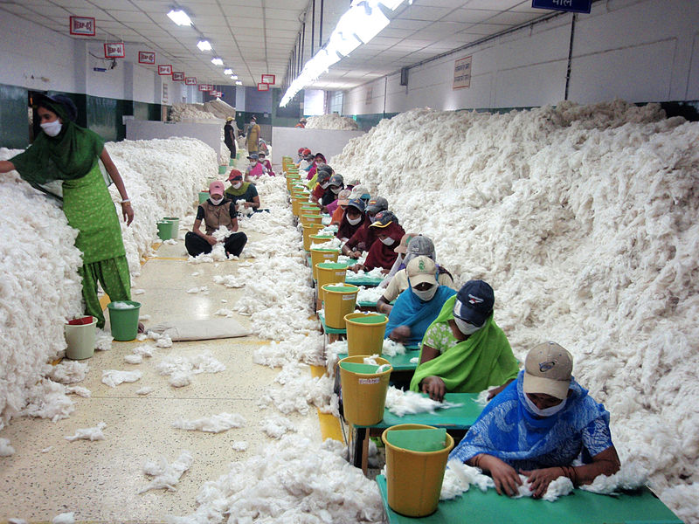
Use
Cotton is widely used to make a lot of cloth materials, such as terrycloth (towels), denim (jeans) and others. The materials are later used to make socks, underwear and mostly T-Shirts. Cotton is also mixed with other materials to become lighter than cotton only.

Slide 6
Thank you for your attention!
Sources:
Google
Wikipedia - Cotton

